Slide 1
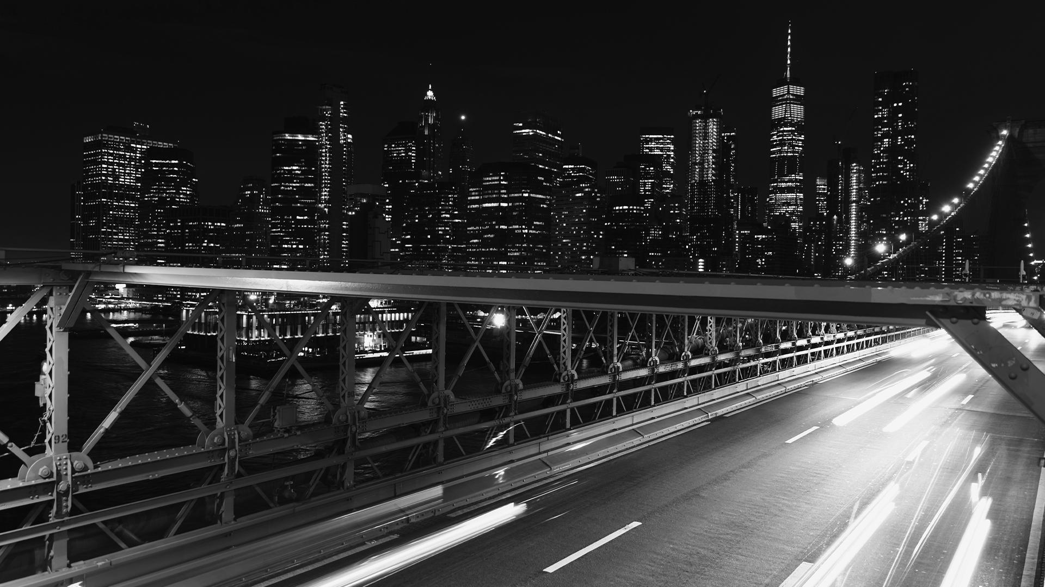

Final Presentation
Traffic Crashes in the US
Mentor: Tony Paek
Marwan Ali

Slide 2
01
Problem Statement
02
Dataset Explanation
03
Conclusion and Insights
04
Options for Improvement
Notes:
The Content of the Presentation
1- Problem Statement Explanation.
2- Dataset Explanation.
3- Conclusion and Insights.
4- Options for Improvements.

Slide 3
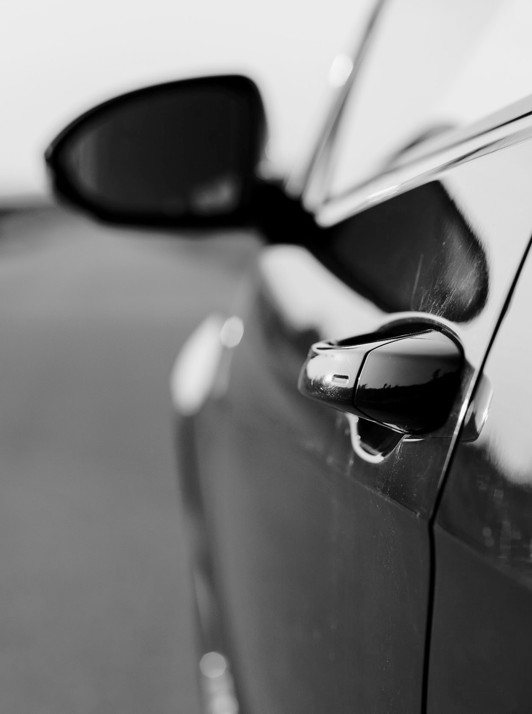
Introduction
Traffic Crashes in the US
Traffic Crashes in Detroit City
The Rise of the Traffic Crashes Since the start of the Pandemic
Notes:
Traffic Crashes In US
Traffic crashes kill as many Americans every year as guns do. The only difference is that Experts say that is preventable (Bolotnikova, 2021).
Traffic Crashes in Detroit City
With more recent data published, Detroit’s crash deaths spiked the last couple of years (Publications: Statewide Reports, n.d.).
The Rise of the Traffic Crashes Since the start of the Pandemic
Data show a rise in traffic accidents since the pandemic started (Golston, H., Komer, D., 2022).

Slide 4
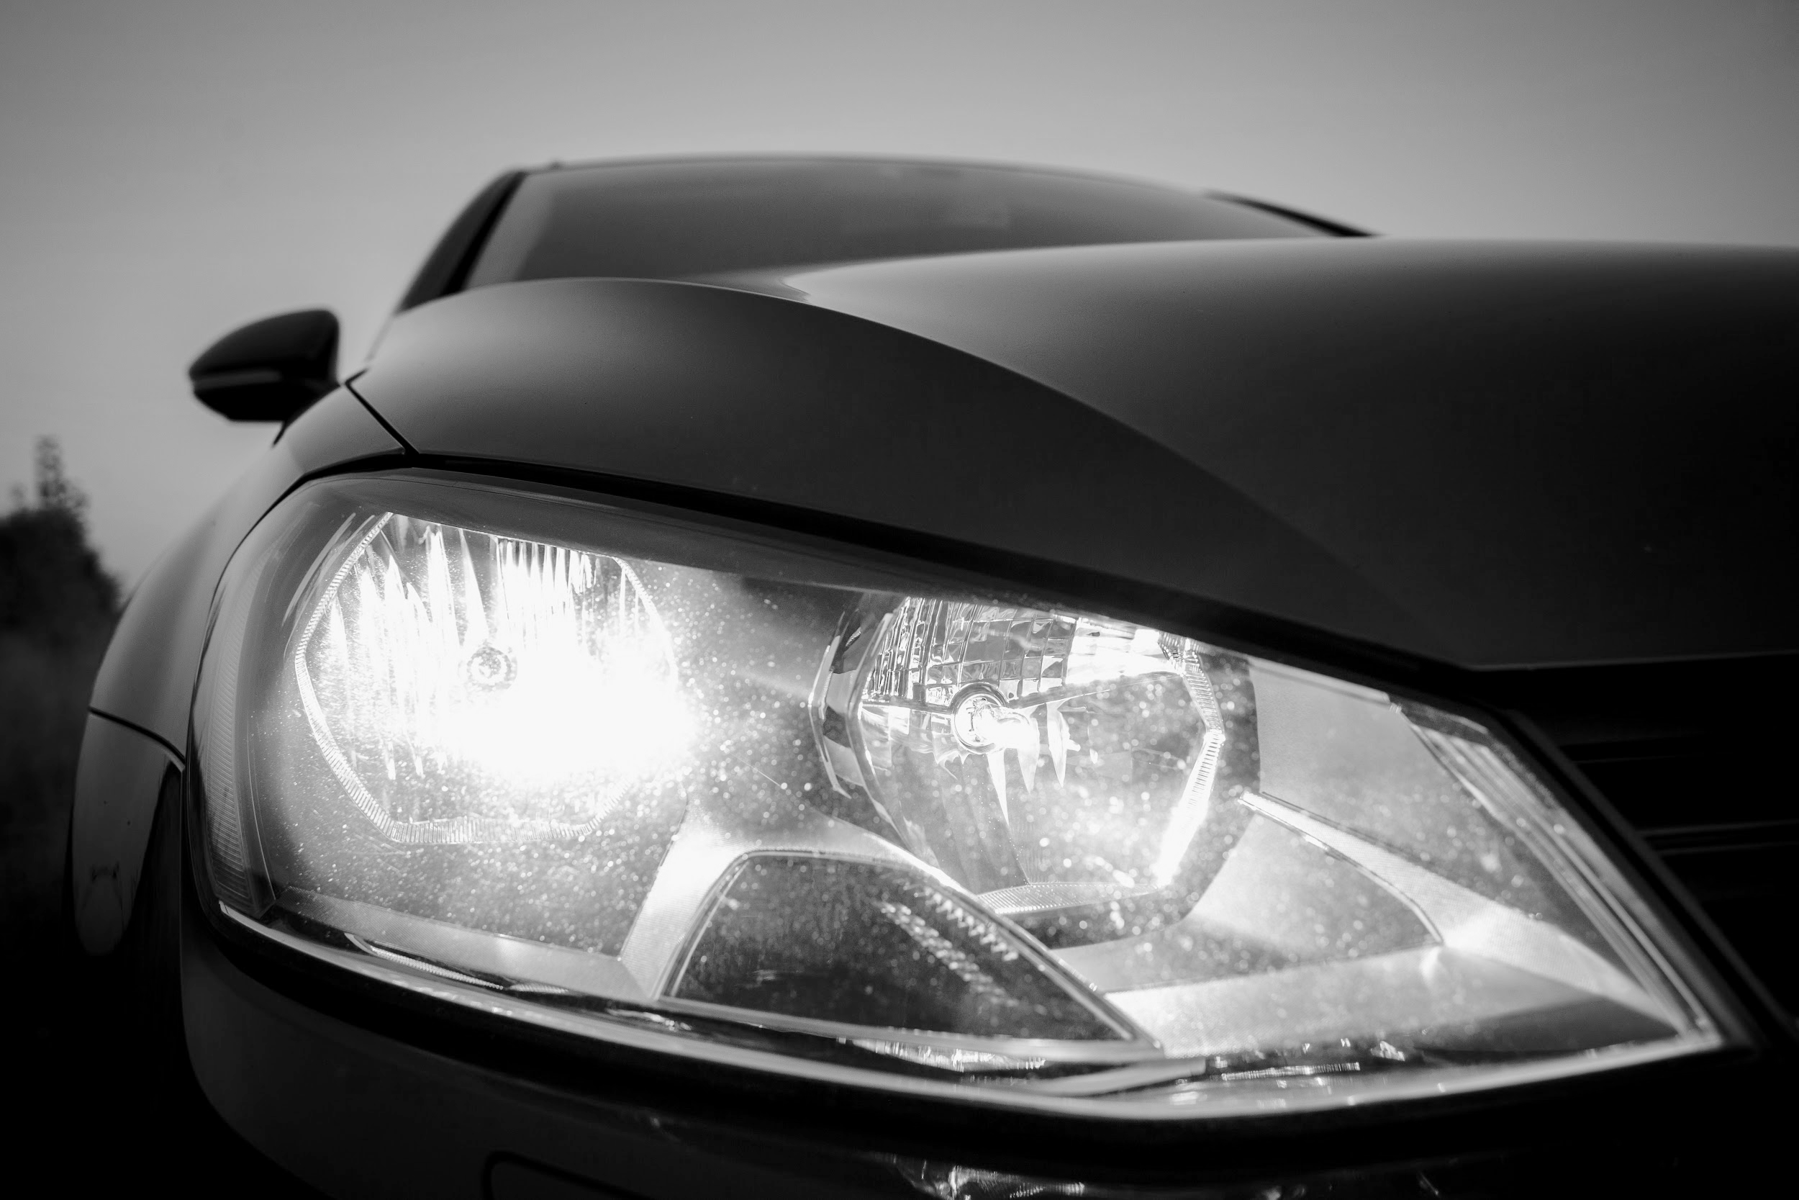
01
The Problem Statement
Does a relationship exist between the human elements and the traffic characteristics regarding the environmental factors that influence the accidents’ likelihood in Detroit.
Notes:
The Problem Statement:
It is not known if and to what extent a relationship exists between the human elements (occupants, young, etc.) and the traffic and roadway characteristics (speed limit, number of lanes, etc.) regarding the environmental factors (date and time, weather, etc.) that influence the accidents’ likelihood and injury severity in Detroit MI.

Slide 5
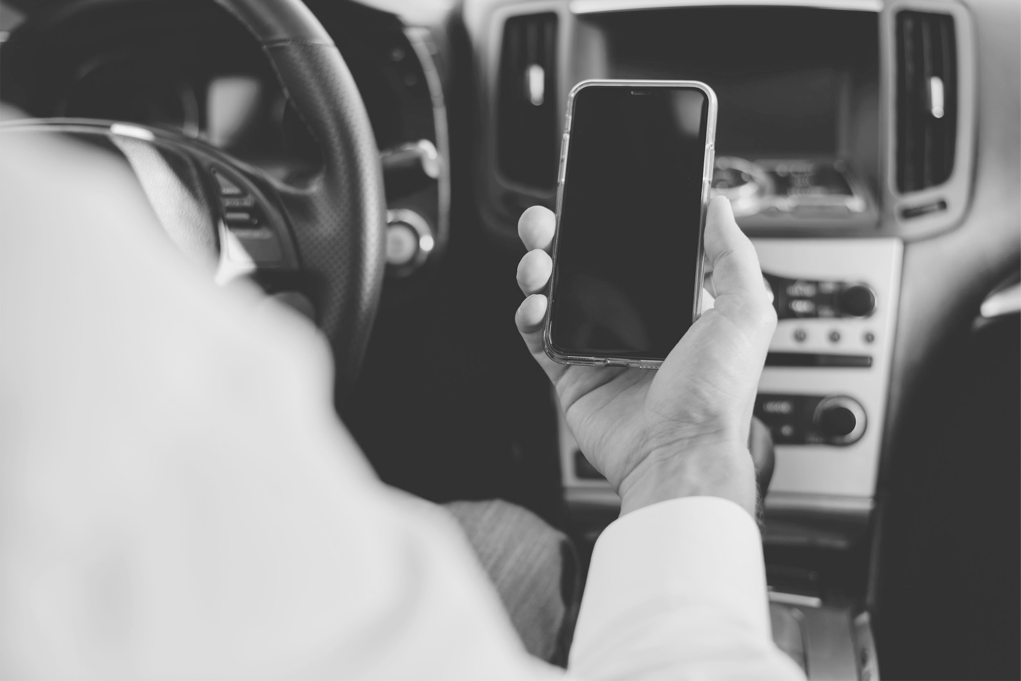
The Problem Statement (Continued)
Background, Need, and City of Detroit Efforts Overview
The Benefits and the Feasibility of the Study
Notes:
Background, Need, and City of Detroit Efforts Overview
The Department of Public Works at the City of Detroit has developed a community involvement program (Streets for People). This plan has one focus — to make it uncomplicated and safer for all Detroiters to walk, move, and pass around the city (Wyche, I., n.d.).
The Benefits and the Feasibility of the Study
The newest evidence proposes that succeeding years of protection achievements, the Pandemic has made U.S. drivers more careless, more likely to leave their seat belts unbuckled, more likely to speed, and use drugs or drink (Golston, H., Komer, D., 2022.
The project seeks to unify the community, prioritize security and protection of the ultimate endangered roadway users, and this study aims to identify the root problems and provide recommendations to support these efforts for refinement and advancement to benefit all Detroiters.

Slide 6
Dataset Explanation
Time Period of the Data
Dataset Content
Data Origin
The Justification of Using the Data
02
2011-2016
Data was used as-is from the E-Crash system at DPD
The data was pre-collected from the city of Detroit’s official website
To lessen traffic crashes and the risk of death
Notes:
The Data Origin: The data was pre-collected from the city of Detroit’s official website (Data.gov, 2021).
Time Period of the Data: The data collected was This research could start a ten-year investigation, starting with available data in hand from 2011 to 2016 and then followed by another examination for a second phase (2017-2021) once the relevant data is available.
The Justification of Using the Data (reasons): This study aims to give new insights that could impose new policies to lessen traffic crashes and the risk of death or fetal injury in Detroit (Pecher , D., Chu, Z., Byrd, V. L., 2020).
Data Set Content: Data was used as-is from the E-Crash system at DPD, excluding any personally identifiable information.

Slide 7
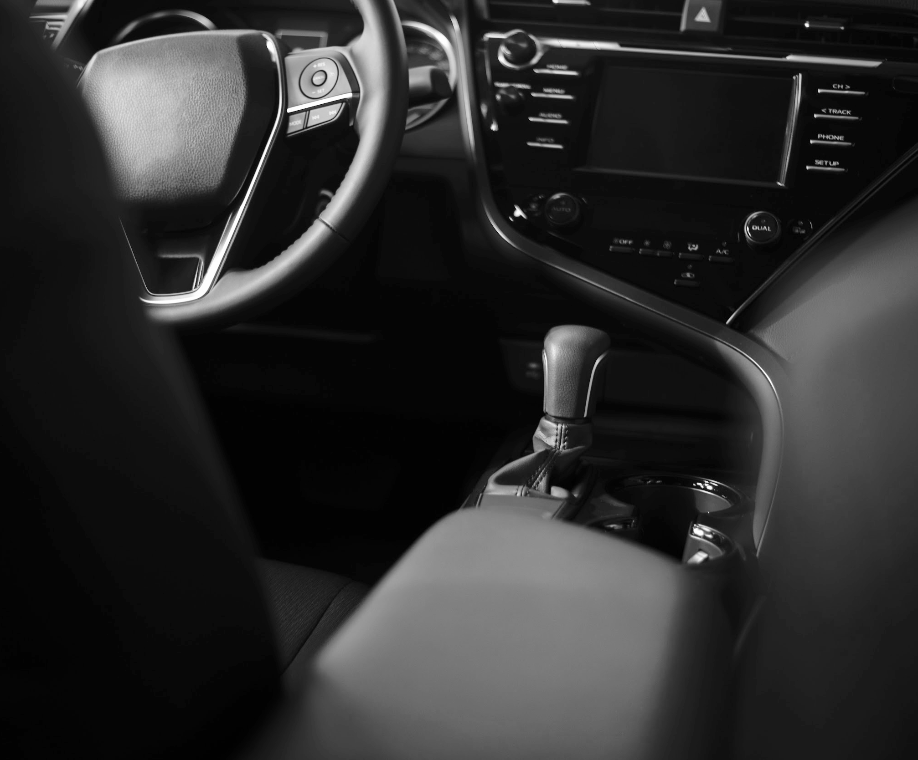
Supportive Conclusions
03
Explanatory Data Analysis (EDA)
Confirmatory Data Analysis (CDA)
Notes:
Explanatory Data Analysis
It involves the process of cleansing, analyzing, transforming, combining, and modeling large datasets to uncover relevant, beneficial information that enables real-time scientific decision-making.
Confirmatory Data Analysis
Confirmatory data analysis is a practical tool for examining the relationships and correlations between variables, it involves an inference about the distribution and visual and numerical descriptions. Different tests and analysis are available to help interpret the results and enhance the decision-making process to investigate the factor correlation for variables.

Slide 8
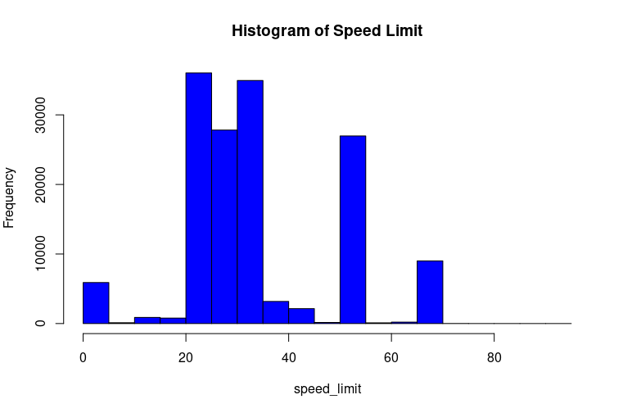
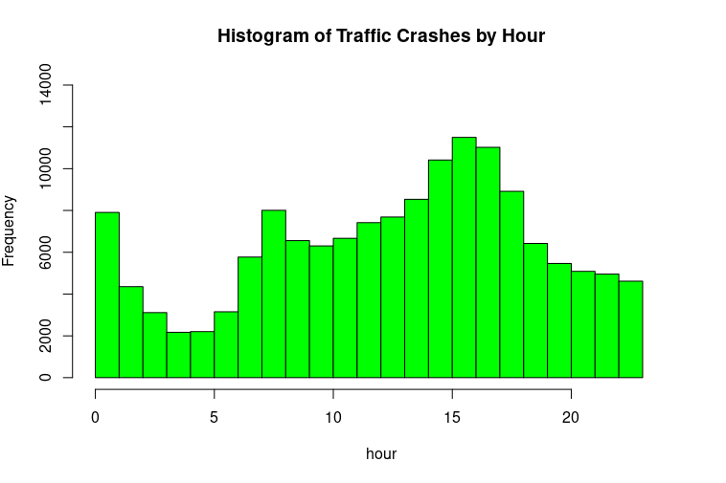
Figure 1 Histogram of Speed Limit
Supportive Conclusions (Continued)
Figure 2 Histogram of Traffic Crashes by hour
Notes:
Histogram of Speed Limit: The medium speed showing the highest frequency between (20 -35) and again at (50- 55) and, also at (65-70) showed in figure (1).
Histogram of Crashes by Hour: Here, from the above plot, the histogram seems stretched towards the right side and the peak is between 03:00 PM and 04:00 PM as it appears in figure (2)

Slide 9
Traffic Crashes by Day of the Week
Traffic Crashes by Number of Lanes
The Most Severe Injuries
Supportive Conclusions (Continued)
Saturday
Small and medium roads
60%
Notes:
Traffic Crashes by Day of the Week: Saturday is the day that has the highest frequency followed by Friday and Sunday, but relatively most of the week ends almost have the same frequency.
Traffic Crashes by Number of Lanes: More attention is required to the small and medium roads as the highest frequency belong to two lanes ways followed by three and four lanes' ways.
The Most Severe Injuries: Many injuries were severe because most accidents were fatal.

Slide 10
Weather Conditions by Total Accidents
The Most Severe Injuries at Different Speeds
Speed Limits and the Number of Crashes
Supportive Conclusions (Continued)
50%
25-35
23-28
Notes:
Weather Conditions by Total Accidents: From all the accidents throughout the five years period half of them took place on severe conditions.
The Most Severe Injuries at Different Speeds: The speeds between (25-35), at (50-55) and at (65-70) have the widest areas
Speed Limits and the Number of Crashes: The range between (23-28) was the most frequent followed by (33-36) and (28-33). (0-2) speed also has high frequency which may indicate that reckless drivers are hitting parked vehicles.

Slide 11
Crash Types
Road Conditions
Density Levels of Young
Density Levels of Elderly
Supportive Conclusions (Continued)
Notes:
Density Levels of Crash Types: The crash types are limited to 12 types and the most frequents ones are between (0-10) and again (97-100). The first range have the highest frequency and density.
Road Conditions: Half of the crashes approximately happened in somewhat normal conditions while the other half is showing extreme conditions.
Density Levels of Young: The two peaks may refer to two main groups between young people that had crashes for totally different reasons. A scatter plot may show more information and could confirm that this is not because of outliers.
Density Levels of Elderly: The result is almost the same as for young but with less density. This confirm that elderly people may have the same issue/ problem but with less frequency. This means young people were in more crashes than elderly.

Slide 12
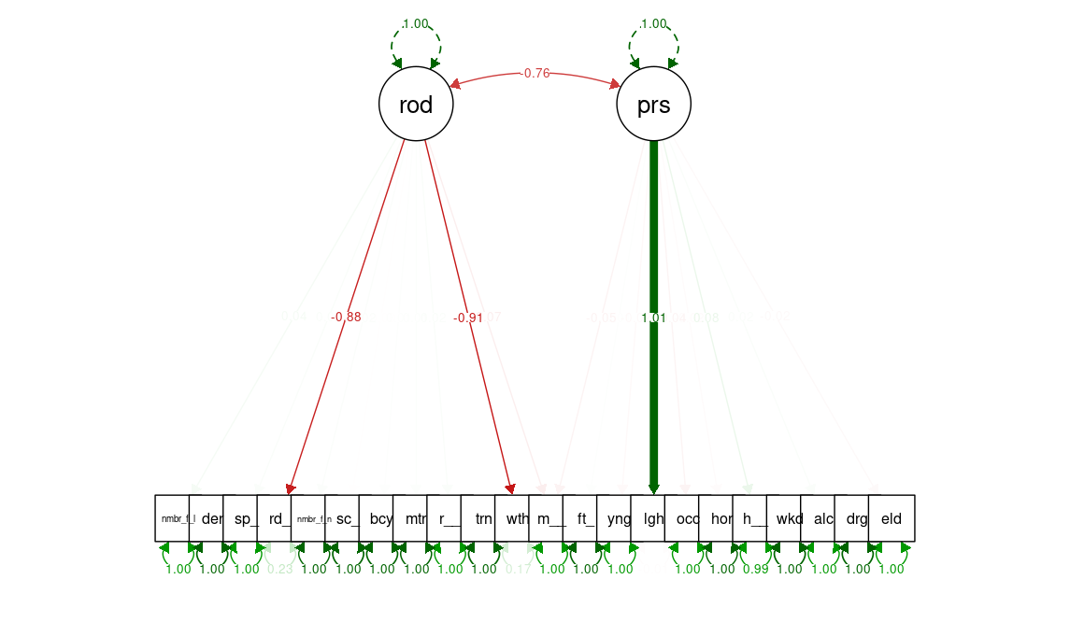
03:00 PM and 05:00 PM
Supportive Conclusions (Continued)
Figure 3 The Path Diagram of Model Two
Time of th Most Crashes
Notes:
The standardized regression coefficient is the value attached to each arrow between the latent variable and an item as it appears in figure (3) (Chen et al., 2016). It indicates the strength of the relationship between an item and the construct. The second model is showing a moderate negative relationship between the latent variable road and the same variables. This time the person variable is showing a very strong positive relationship with lighting. This confirms the same findings we found on the explanatory data analysis phase as the most crashes are happening in the middle of the day between (03:00 PM and 05:00 PM) under the sun light. The second model incorporated (most severe energy) as it belongs to both latent variables. This also confirms that the second version improved the results.

Slide 13
Model One
Model Two
Model Three
Supportive Conclusions (Continued)
Liner Regression
Logistic Regession
K-Nearest Neighbor
Notes:
Unlike other previous algorithms, KNN is a non-parametric model, so it does not make assumptions about the data set. This makes it more efficient since it can handle actual data (Miglani, A., Kumar, N., 2019).
The K-nearest neighbor showed a great accuracy level after validating the results. It gives more reliable information than the previous models. Both models had a low R squared and needed several updates to get more insights as the data is extensive. The data have been studied for the training phase, and the prediction accuracy was high. Both regression and logistic models didn’t predict the data points as KNN does.

Slide 14
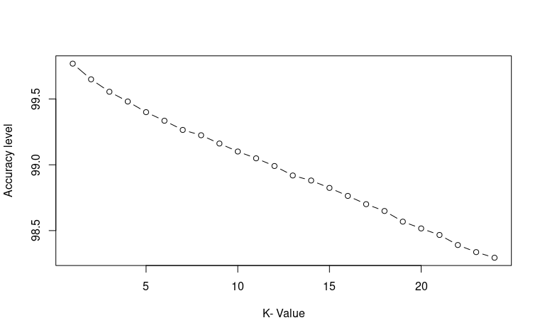
96% Accuracy Level
Supportive Conclusions (Continued)
Figure 4 The Accuracy Plot
K-Nearest Neighbor
Notes:
After building the model and getting the results, the model was evaluated for accuracy, and a confusion matrix was generated to calculate the accuracy. The model developed high accuracy percentage; however, to further improve that, we optimized the model and created the accuracy plot in figure 4.

Slide 15
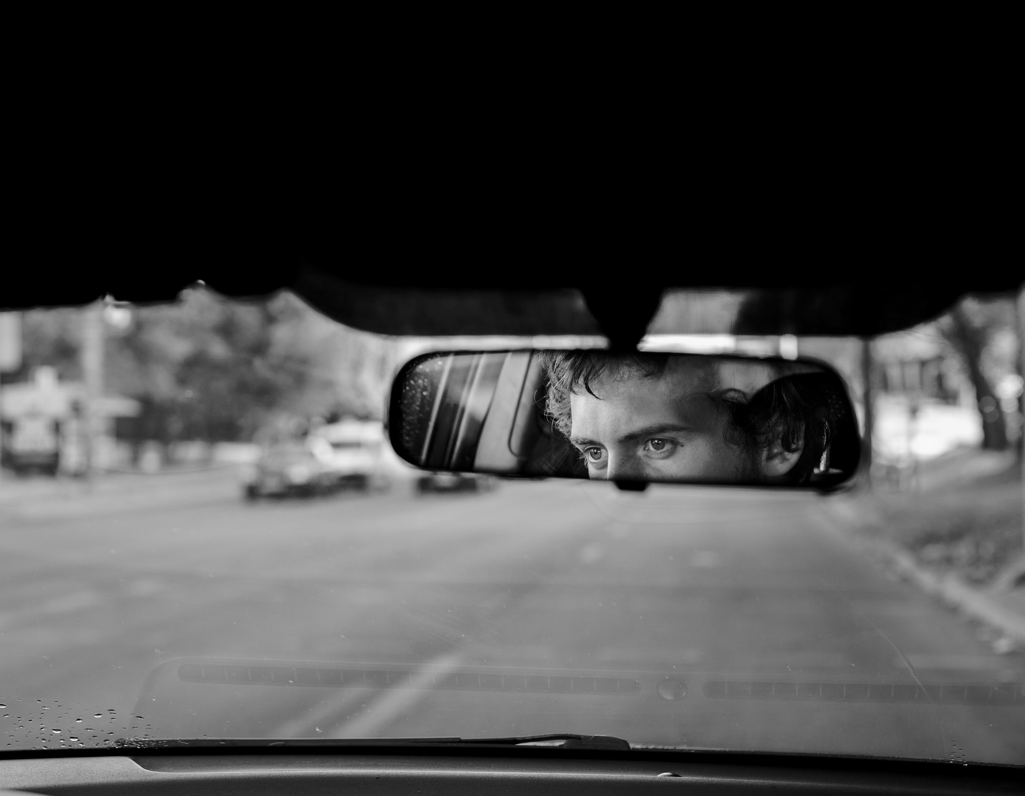
Apply the same approach to different datasets.
04
Recommendations for Improvements
Apply different approaches to the same dataset
Notes:
The KNN is the best model. It satisfies the problem statement and can classify the accidents data into two classes: fatal count or severe injury, non-fatal count, and non-severe injury; however, it should be noted that further testing of the approach on other crash datasets is required to validate the method further.
Build new models and apply it to the data and compare the results as many studies recommended different approaches to handle crash data

Slide 16
Conclusion
Keep the roads compact
Decrease traffic speed
Design streets for people and cars
Safe and convenient public transportation
Incorporating data mapping techniques
Notes:
Short block lengths, as well as concentrated housing and business districts, allow easy, walkable access to public transit and reduce dependence on personal motor vehicles.
The faster drivers are speeding, the more likely they are to kill or severely injure anyone they might hit. The analysis suggests traffic-calming measures such as speed bumps, raised pedestrian crossings, and sidewalk extensions to slow cars inside the city.
Pedestrian islands, wide sidewalks, plazas and bike lanes are all part of an environment that reduces the primacy of the automobile—as well as fatalities.
systems such as this one can cut traffic death and catastrophic injuries from crashes in half.
With modern data-collection capacity, analyzing patterns of danger becomes much easier, allowing officials to put resources into the intersections and streets that pose the greatest risk to citizens.

Slide 17
References
Bolotnikova, M. (2021, September 19). America’s car crash epidemic. Vox. https://www.vox.com/22675358/us-car-deaths-year-traffic-covid-pandemic
Chen, T., Zhang, C., Xu, L. (2016). Factor analysis of fatal road traffic crashes with massive casualties in China. Advances in mechanical Engineering, 8(4), 1–11. https://doi.org/10.1177/1687814016642712
Data.gov. (2021). Data Catalog, Traffic Crashes. [Data set]. https://catalog.data.gov/dataset/traffic-crashes
Golston, H., Komer, D. (2022, February 22). Despite less traffic on the road, new data shows rise in crashes since pandemic. Fox2 Detroit. https://www.fox2detroit.com/news/despite-less-traffic-on-the-road-new-data-shows-rise-in-crashes-since-pandemic
Miglani, A., Kumar, N.,. (2019). Deep learning models for traffic flow prediction in autonomous vehicles: A review, solutions, and challenges. Vehicular Communications, 20, Article 100184. https://doi.org/10.1016/j.vehcom.2019.100184
Pecher , D., Chu, Z., Byrd, V. L. (2020, October 1–8). Developing Research Questions: A method for transforming a question into a problem statement [Conference session]. Frontiers in Education Conference (FIE), 2020 IEEE, Uppsala, Sweden. http://10.1109/FIE44824.2020.9274275

Slide 18
References
Renda, D. (2021). Feeling Free [Recorded by D. Renda]. Commercial Music [Online]. Rancho Cordova, CA: Fesliyan Studios Inc. (2021) https://www.fesliyanstudios.com/royalty-free-music/download/feeling-free/1558
Renda, D. (2019). Feeling the Best [Recorded by D. Renda]. Commercial Music [Online]. Rancho Cordova, CA: Fesliyan Studios Inc. (2019)
https://www.fesliyanstudios.com/royalty-free-music/download/feeling-the-best/484
Transport App Pitch Deck [PowerPoint slides]. (n.d.). Slidesgo. https://slidesgo.com/theme/transport-app-pitch-deck#search-car&position-10&results-17
Wyche, I. (n.d.). Streets for People. City of Detroit. https://detroitmi.gov/departments/department-public-works/complete-streets/streets-people

